Slide 1

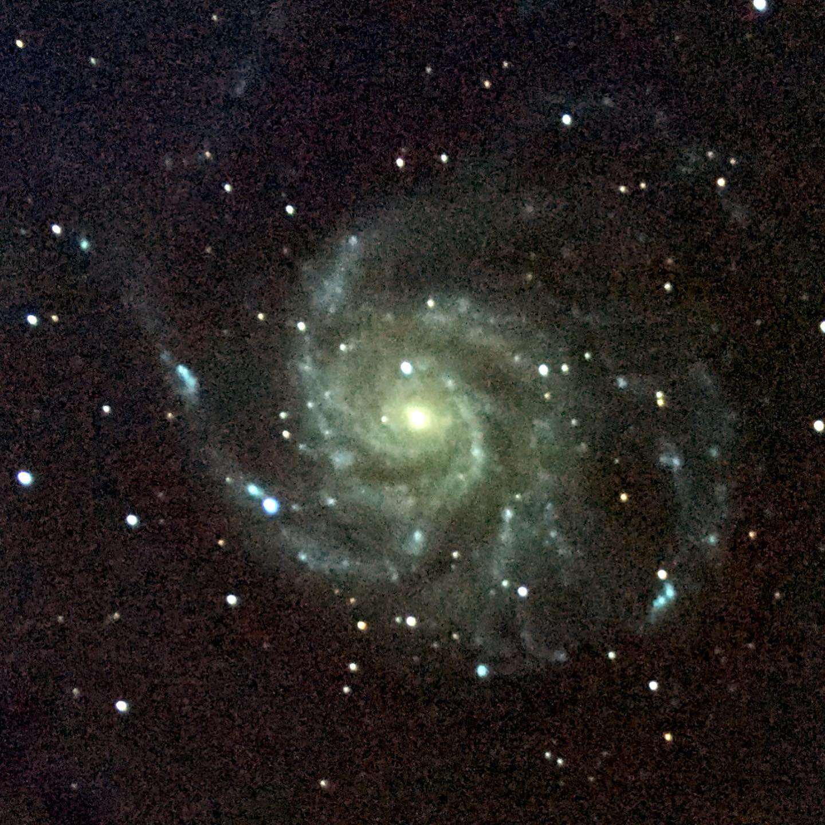
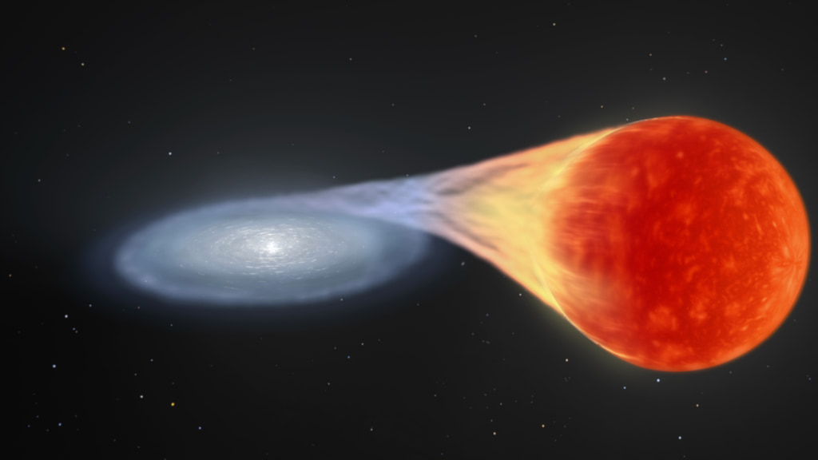
Predicting Hubble Residuals Using Host Galaxy Properties
By: Mykola Chernyashevskyy

Slide 2
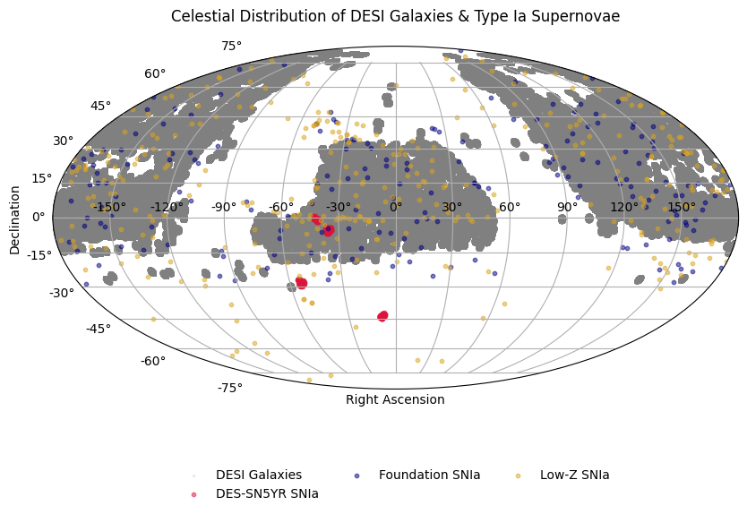
Background
The Dark Energy Survey Supernova Program: Light Curves and 5 Yr Data Release: collected multi-band light curves for ~1600 SNe Ia and estimated host properties through photometry and spectroscopy.
Data Release 1 of the Dark Energy Spectroscopic Instrument (DESI) provides redshifts and host galaxy parameters for galaxies.

Slide 3
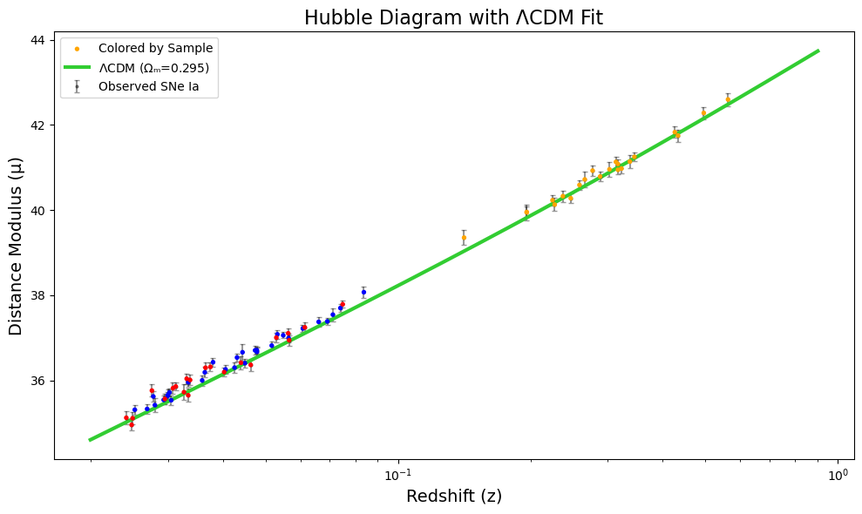
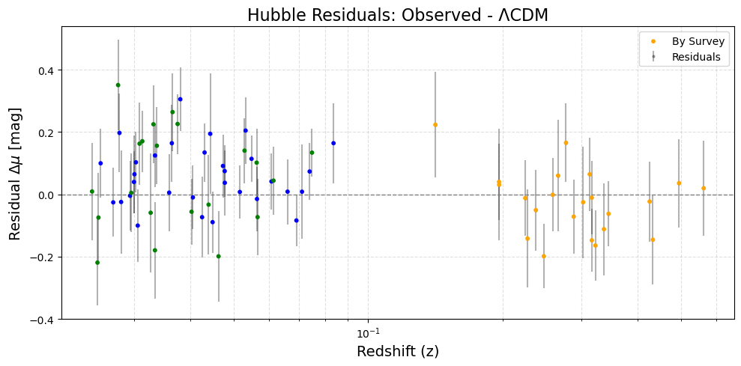
Motivation and Research Goal:
Identify host galaxy properties that correlate with or predict Hubble residuals.
Cosmology:
Flat Lambda CDM
H0 = 70
Matter Density = 0.315

Slide 4
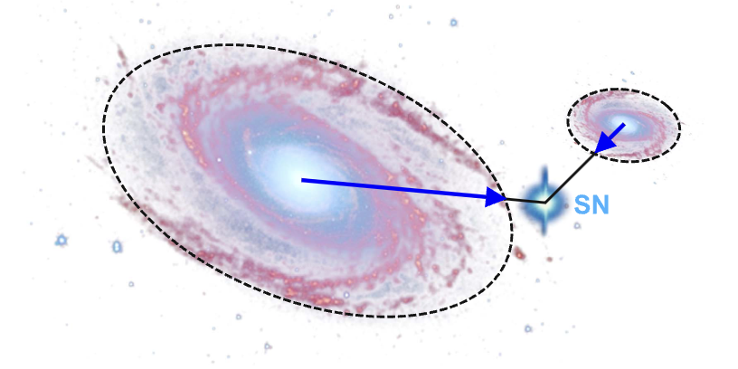
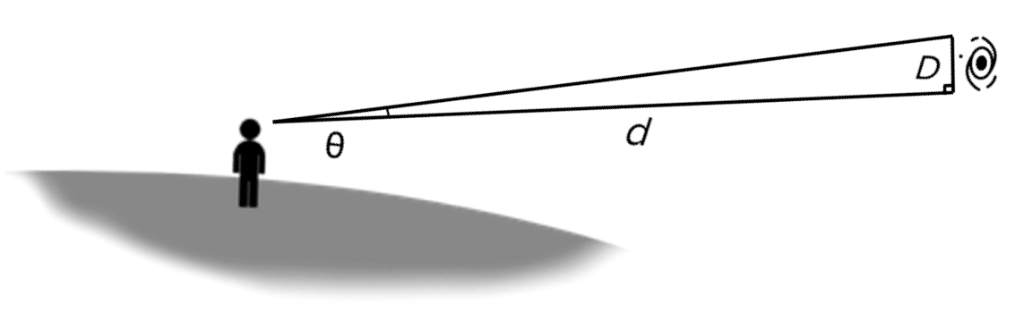

Method - Matching Galaxy to SNIa
Half Light Radius: - the radius within which half of an object’s total light (or luminosity) is emitted.
5 half light radii are standard based on literature (Lunnan et al. 2016, Gupta et al. 2018).
Half light radii for each galaxy provided by DESI data set.
[*] SNIa between two galaxies. Dotted lines
represent light radii (Scolnic & Kessler et al. 2016)

Slide 5
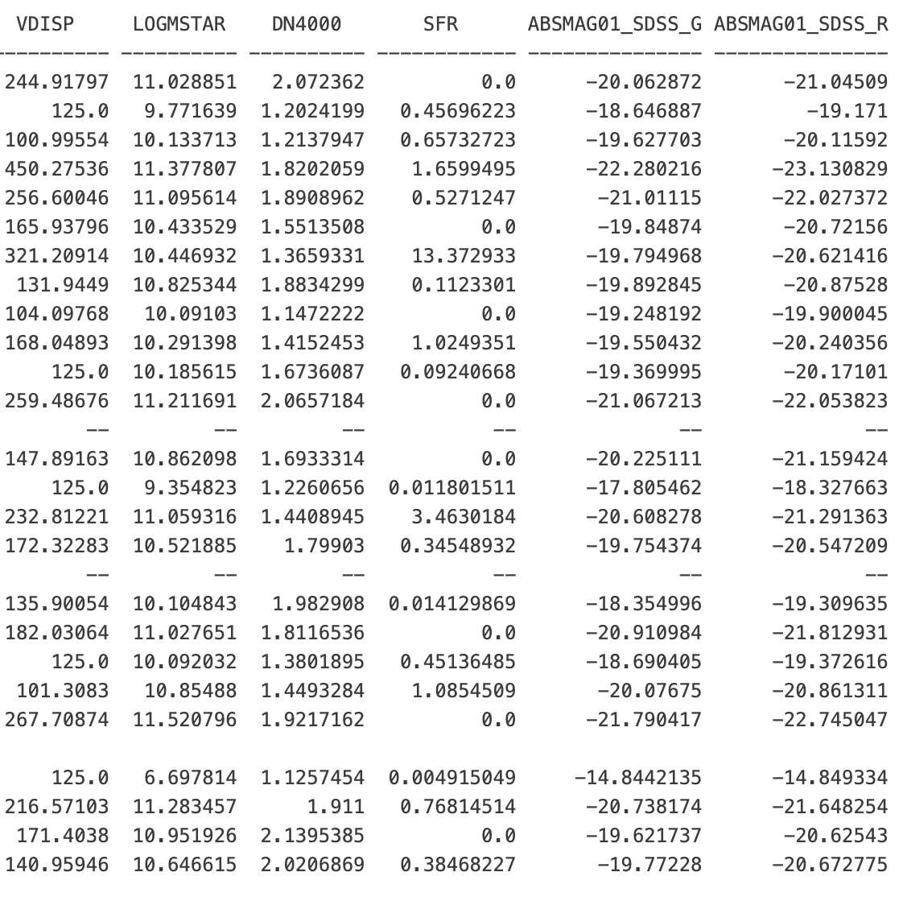
Data and Observations
129 Galaxy – SNIa matches were found.
Due to incomplete SNIa data (missing mu) and incomplete DESI data (missing Galaxy parameters) 67 SNIa – Galaxy Matches and we work with 67 data points.

Slide 6
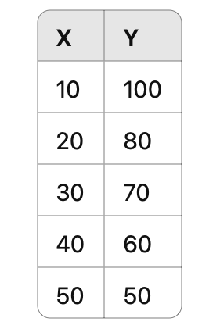
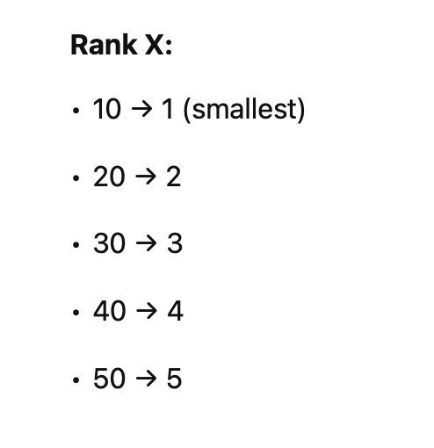
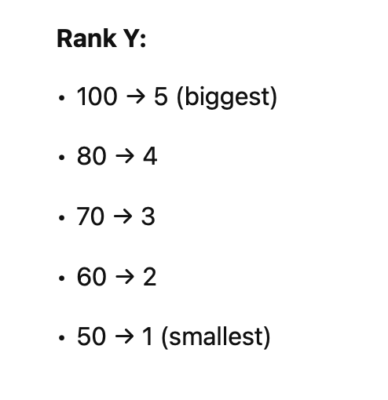
Methods – Spearman Correlation Coefficient
Key Points:
Measure of monotonic relationship between two variables.
Based on rank order: not actual values — robust against outliers. Good at quantifying non linear relationships.

Slide 7
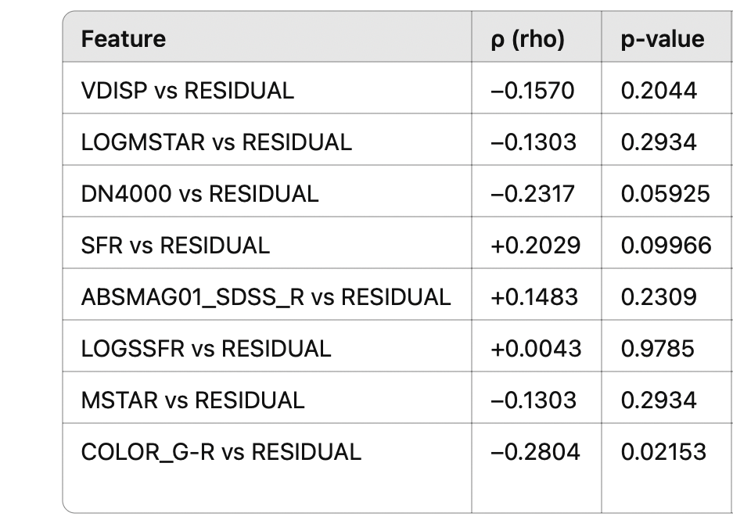
Results – Spearman Correlation Coefficent
Great at estimating which galaxy properties are “good” for training.
rho, pval = spearmanr(x, y)
P – Value cutoff chosen to be 0.05 by standard convention.
DN4000 - measures the strength of spectral break at 4000A – caused by old stars containing ionized metals (age of galaxy).
SFR – Star formation rate
Color G-R - related to age of galaxy (higher G-R older galaxy).

Slide 8
Methods - kNN, Random Forest, XGBoost
 | kNN | Random Forest | XGBoost
Modeling Approach | Stores all data; no model building | Builds many independent decision trees on random data subsets | Builds trees sequentially, each correcting previous errors
Prediction Method | Finds k nearest neighbors; averages their outputs | Averages outputs from all trees | Sums weighted outputs from all sequential trees
Optimization/Training | No optimization; just distance calculations | Randomized splits to minimize variance per tree | Gradient-based

Slide 9
Methods – Cross - Validation
Used instead of train/test split becaue number of data pts. Is low (~60).
For a 5 fold CV:
Train on 4/5 of the data.
Predict on the 1/5 left out.
This process is repeated 5 times, each time leaving a different 1/5
Then you compute metrics based on these predictions.

Slide 10
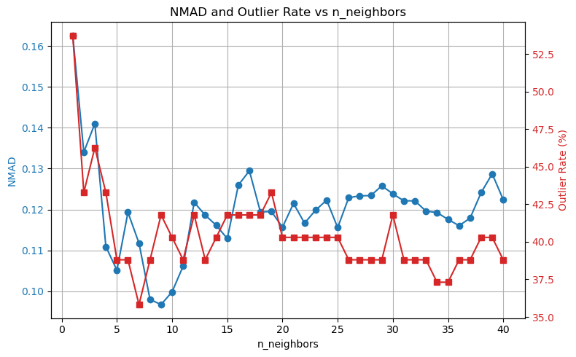
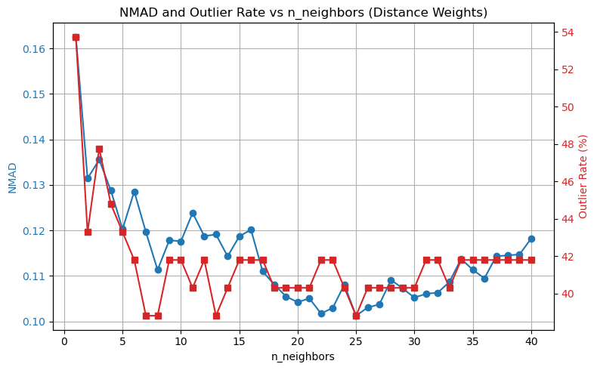
Parameter Tuning Results - kNN
The galaxy properties reflect meaningful physical differences, not noise. Otherwise weighing by distance would have imporved results.
Outlier Rate is Too high For conclusive Evidence.

Slide 11
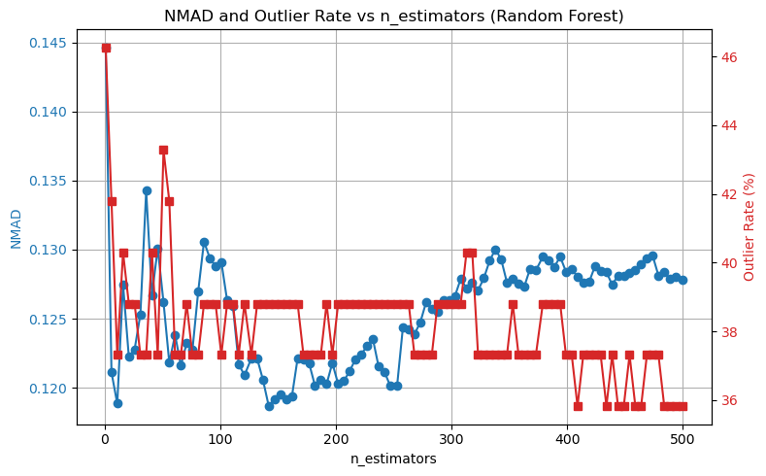
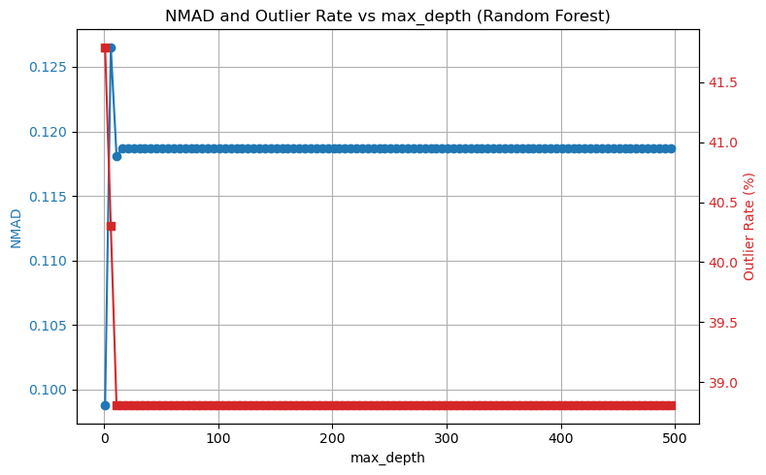
Parameter Tuning Results – Random Forest
NMAD Values Get low.
Outlier Rate is Too high For conclusive Evidence.

Slide 12
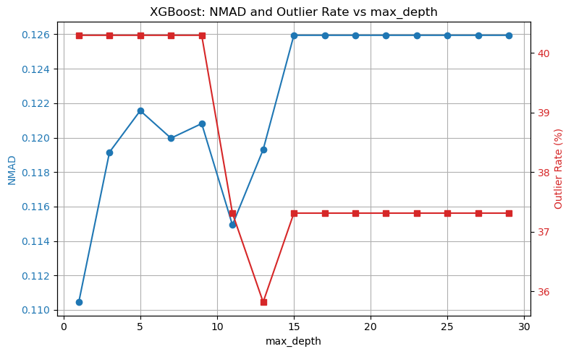
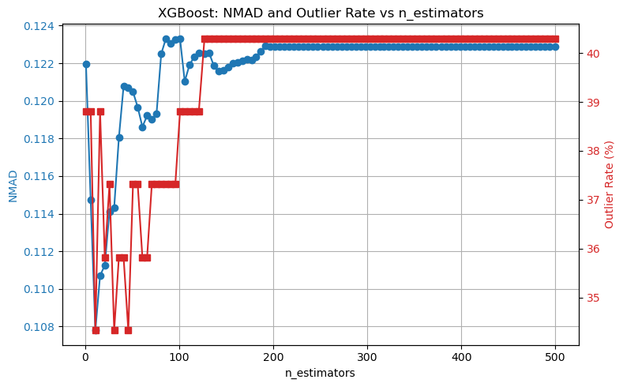
Prameter - Tuning XGBoost
NMAD Values Get low.
Outlier Rate is Too high For conclusive Evidence.

Slide 13
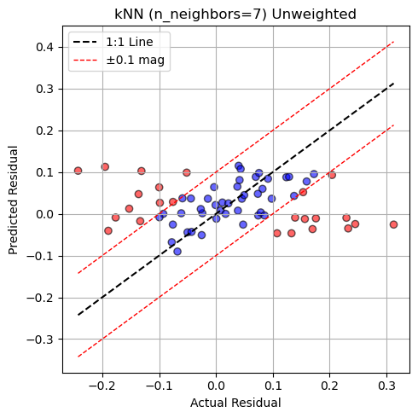
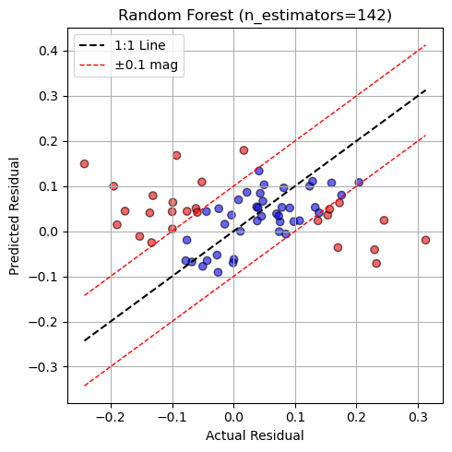
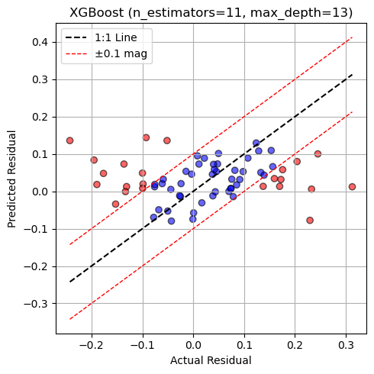
Results kNN, Random Forest, XGBoost
NOTE: +/- 0.1 mag is intrinsic scatter of SNIa in Universe according to Scolnic 2018
Outlier rate (> ±0.1 mag): 35.82% NMAD: 0.1118
Outlier rate (> ±0.1 mag): 38.81%
NMAD: 0.1187
Outlier rate (> ±0.1 mag): 34.33%
NMAD: 0.1043

Slide 14
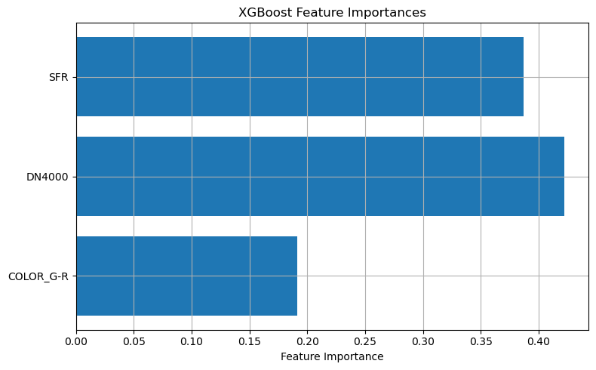
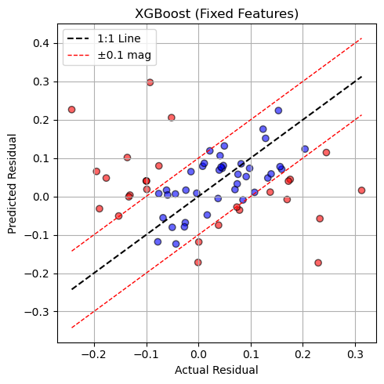
Future Work
Reconstruct mu from the DES5YR data set.
Lots of data points missing b/c there was no mu recorded as part of data set and it can be computed from z under a chosen cosmology.
Focus more on XGBoost and try various parameters to tune.
Read papers to try to identify why NMAD is good and outliers are bad.
Test more galaxy features using SPEARMAN and NMAD.
NMAD: 0.1216
Outlier Rate (> ±0.1 mag): 40.30%

